Slide 1
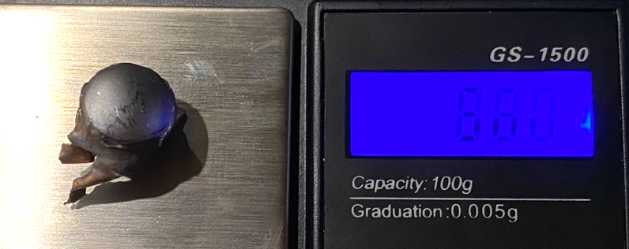
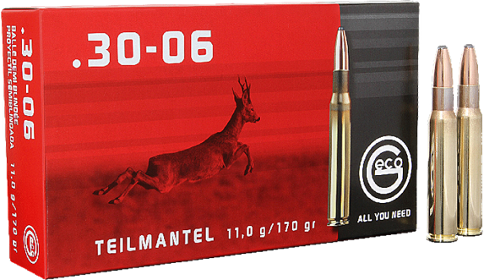
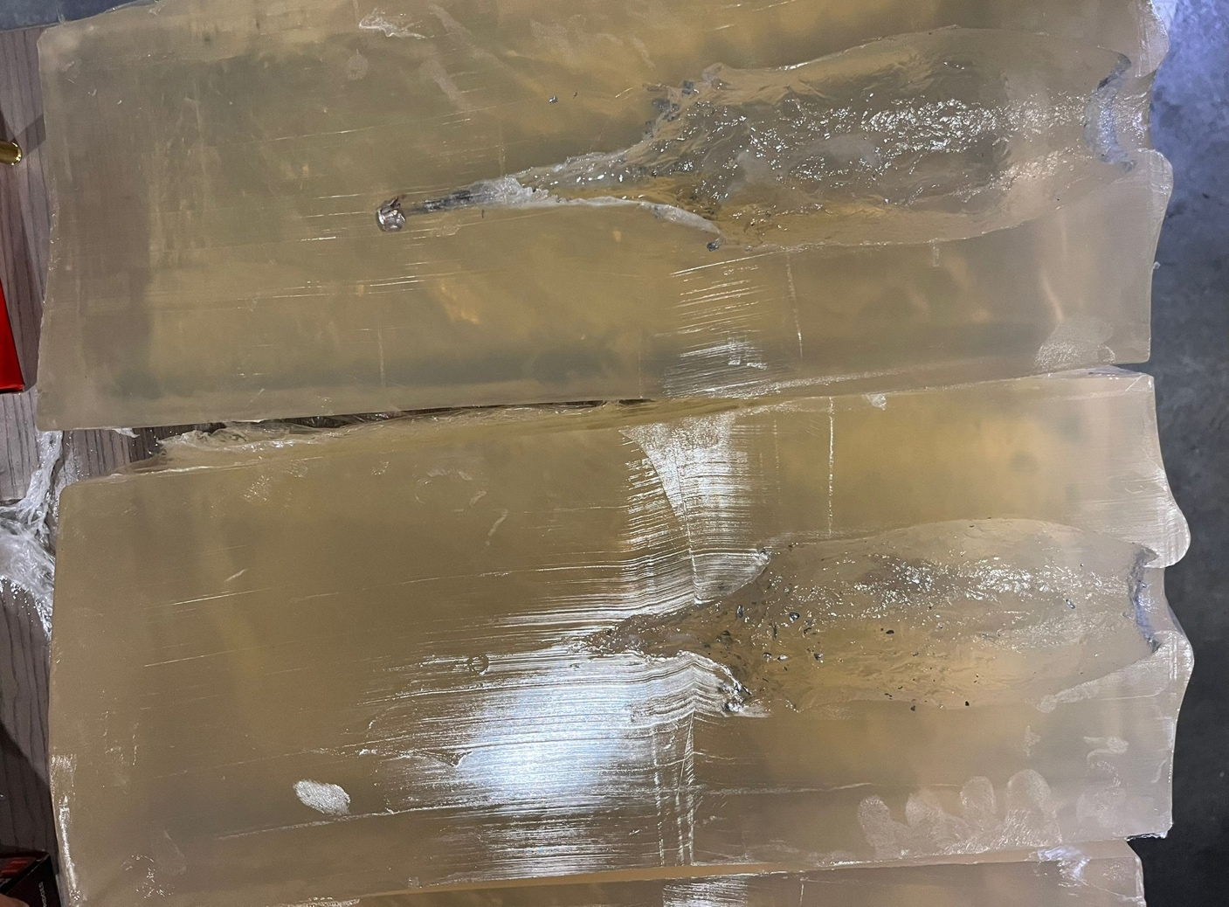
RESULTS BALLISTIC SOAP SHOOT
30.09.2023
Ammunition | 170 gr/11 g Geco Teilmantel
Caliber | 30-06 Springfield
Gun | Savage 110 Hunter
Barrel length, twist | 22“/56 cm, 1-10“
Muzzle velocity, ES | 818 m/s, 8 m/s
Energy | 3.685 Joule
Accuracy/rounds/distance | Not tested (20 m)
Maximum penetration | 32,5 cm
Volume of the cavity | 872 ml
Path to start of bullet expansion /entrance diameter | 0 mm / 3 cm
Maximum diameter of the cavity | 8,5 cm
Path until maximum diameter of the cavity | 8,5 cm
Length of the cavity | 26 cm
Bullet diameter | 11,98 mm
Remaining bullet weight | 87,8 gr. / 52%
Distance to target | 20 m
Dimensions of the ballistic soap | 20x20x50 cm
Location | Hungary
remarks | 20°C, new transparent material

Slide 2
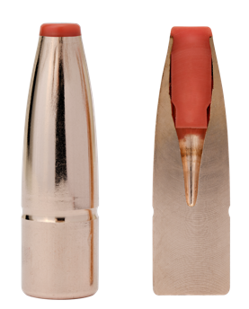
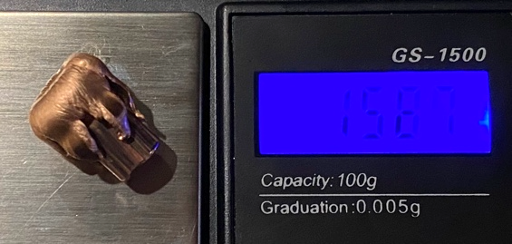
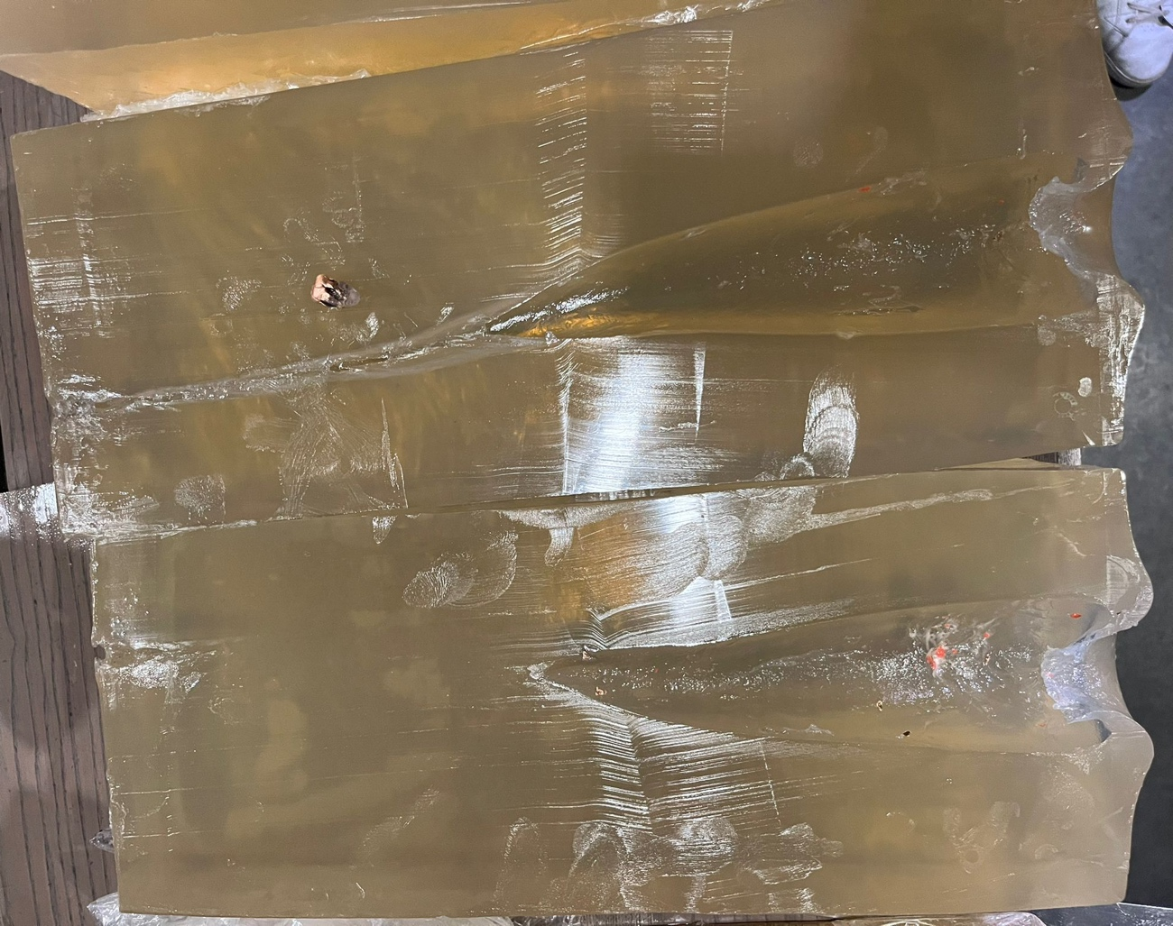
RESULTS BALLISTIC SOAP SHOOT
30.09.2023
Ammunition | 165 gr/10,7 g Hornady 811614 ECX International
Caliber | 30-06 Springfield
Gun | Savage 110 Hunter
Barrel length | 22“/56 cm, 1-10“
Muzzle velocity, ES | 818 m/s, 14 m/s
Energy | 3.577 Joule
Accuracy/rounds/distance | Not tested (20 m)
Maximum penetration | 50 cm
Volume of the cavity | 710 ml
Path to start of bullet expansion /entrance diameter | 0 cm / 4 cm
Maximum diameter of the cavity | 7,4 cm
Path until maximum diameter of the cavity | 3,5 cm
Length of the cavity | 33 cm
Bullet diameter | 30,7 mm
Remaining bullet weight | 158,7 gr / 96%
Distance to target | 20 m
Dimensions of the ballistic soap | 20x20x50 cm
Location | Hungary
remarks | 20°C, new transparent material

Slide 3
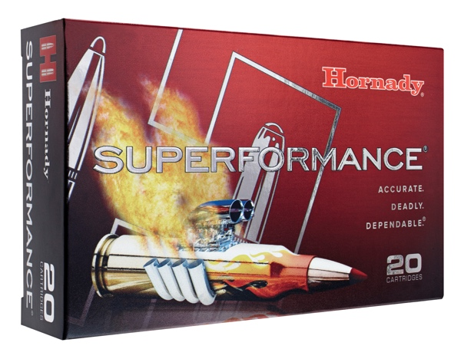
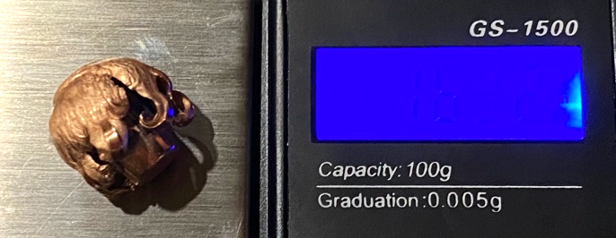
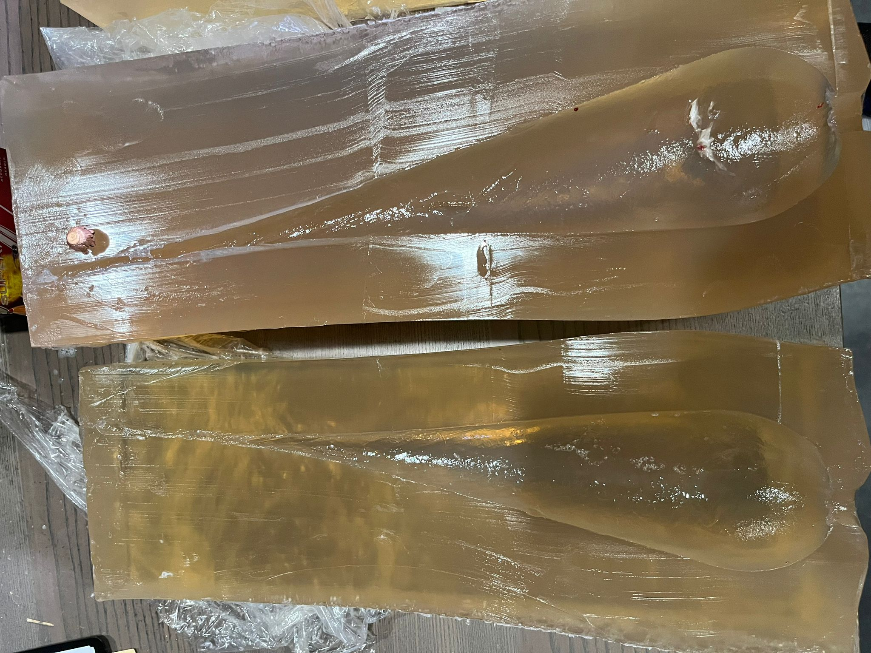
RESULTS BALLISTIC SOAP SHOOT
30.09.2023
Ammunition | 165 gr / 10,7 g Hornady CX 81169 Superformance
Caliber | 30-06 Springfield
Gun | Savage 110 Hunter
Barrel length | 22“/56 cm, 1-10“
Muzzle velocity, ES | 897 m/s, 3 m/s
Energy | 4.301 Joule
Accuracy/rounds/distance | Not tested (20 m)
Maximum penetration | 50 cm+ (Exit)
Volume of the cavity | 987 ml
Path to start of bullet expansion /entrance diameter | 0 cm / 2,2 cm
Maximum diameter of the cavity | 9,5 cm
Path until maximum diameter of the cavity | 5,2 cm
Length of the cavity | 32 cm
Bullet diameter | 15,5 mm
Remaining bullet weight | 163,3 gr / 99%
Distance to target | 20 m
Dimensions of the ballistic soap | 20x20x50 cm
Location | Hungary
remarks | 20°C, new transparent material

Slide 4
RESULTS BALLISTIC SOAP SHOOT
30.09.2023
The results in comparison
Ammunition | 170 gr / 11 g Geco Teilmantel | 165 gr / 10,7 g Hornady ECX International | 165 gr / 10,7 g Hornady CX Superformance
Caliber | 30-06 Springfield | 30-06 Springfield | 30-06 Springfield
Gun | Savage 110 Hunter | Savage 110 Hunter | Savage 110 Hunter
Barrel length | 22“/56 cm, 1-10“ | 22“/56 cm, 1-10“ | 22“/56 cm, 1-10“
Muzzle velocity, ES | 818 m/s, 8 m/s | 818 m/s, 14 m/s | 897 m/s, 3 m/s
Energy | 3.685 Joule | 3.577 Joule | 4.301 Joule
Accuracy/rounds/distance | Not tested (20 m) | Not tested (20 m) | Not tested (20 m)
Maximum penetration | 32,5 cm | 50 cm | 50 cm+ (Exit)
Volume of the cavity | 872 ml | 710 ml | 987 ml
Path to start of bullet expansion /entrance diameter | 0 mm / 3 cm | 0 cm / 4 cm | 0 cm / 2,2 cm
Maximum diameter of the cavity | 8,5 cm | 7,4 cm | 9,5 cm
Path until maximum diameter of the cavity | 8,5 cm | 3,5 cm | 5,2 cm
Length of the cavity | 26 cm | 33 cm | 32 cm
Bullet diameter | 11,98 mm | 30,7 mm | 15,5 mm
Remaining bullet weight | 87,8 gr. / 52% | 158,7 gr / 96% | 163,3 gr / 99%
Distance to target | 20 m | 20 m | 20 m
Dimensions of the ballistic soap | 20x20x50 cm | 20x20x50 cm | 20x20x50 cm
Location | Hungary | Hungary | Hungary
remarks | 20°C, new transparent material | 20°C, new transparent material | 20°C, new transparent material
Best values in blue

Slide 5
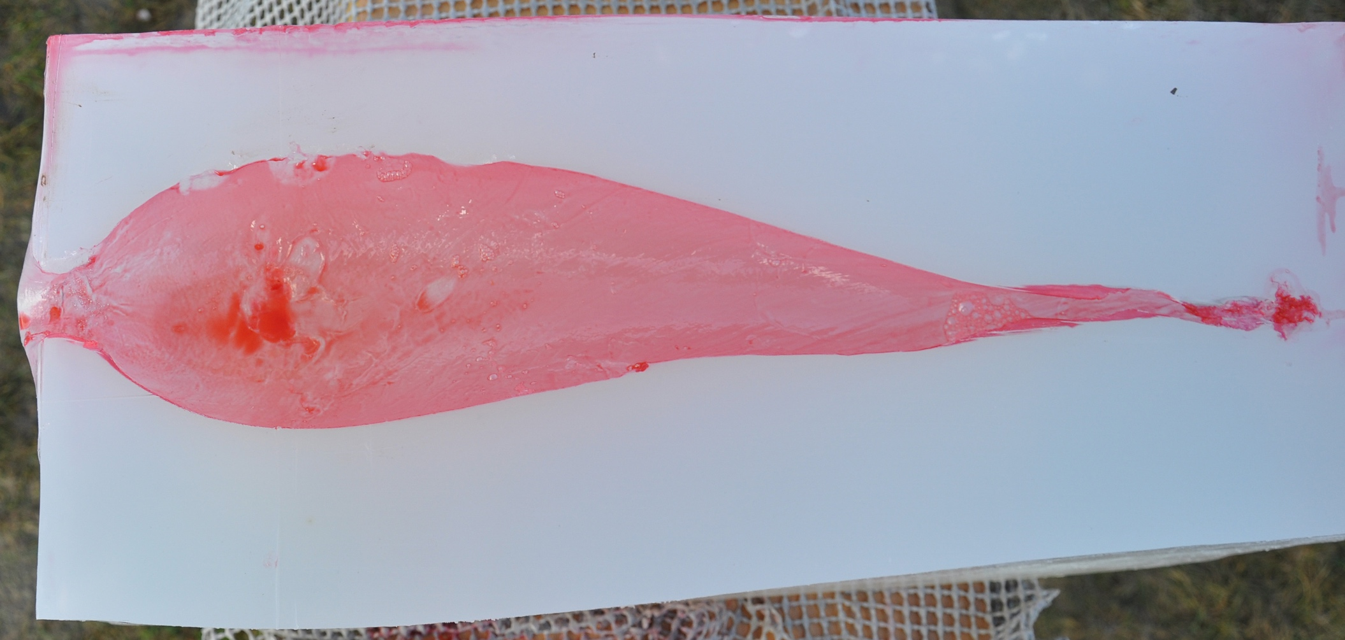
To assess the performance of hunting ammunition in ballistic soap, the following parameters are decisive in this order:
1. Volume of the temporary cavern - (here visualized by measuring with red colored water). The greatest possible destruction and displacement of tissue is required for rapid and reliable onset of the game-killing effect. The larger the temporary cavern in the soap block, the greater the tissue destruction to be expected.
2. Path to the maximum diameter of the temporary cavern - The quicker the maximum diameter of the cavern is reached, the stronger the expected immediate effect.
3. Maximum Temporary Cavern Diameter - The larger the maximum diameter of the cavern, the greater the expected tissue destruction.
4. Maximum penetration - The greater the maximum penetration, the better the expected depth effect and the higher the probability of a reject.
5. Cavern length – value up to which penetration depth the bullet destroys/displaces tissue beyond its actual diameter.
For the sake of completeness, the values for distance to bullet deformation, expanded bullet diameter and residual weight were recorded. Bullet energy and/or bullet velocity alone say nothing about the effectiveness of the charge, because only the above data provide information about whether the performance of the charge translates into tissue destruction.
Shot direction
2.
3.
1.
4.
5.

